Slide 1
BANKING database MANAGEMENT SYSTEM
By team - 4

Slide 2
TEAM – 4 TEAM MEMBERS
Swati Gupta – 160784
Rohitha Sai Alla – 160554
Anusha Lenkapothula – 160656
Sumanth Kasanagottu– 160619
Panchanan Pramanik – 161792

Slide 3
TABLE OF CONTENTS
Objective
Abstract
Client Requirements
Planning Phase
Software Requirements
Tables Used
Entity Relationship Diagram (ERD)
Software Architecture

Slide 4
Objective
Designing the database, developing the queries and performing the operations on banking database.

Slide 5
Abstract
This database is used to perform basic operations by bankers like viewing balance or transacting money.

Slide 6
CLIENT REQUIREMENTS
Viewing the balance
Creating new account
Debiting money
Crediting money
Transferring money
Admin

Slide 7
Entity relationship diagram

Slide 8
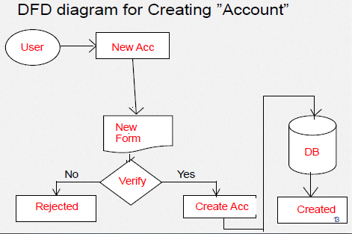

Slide 9
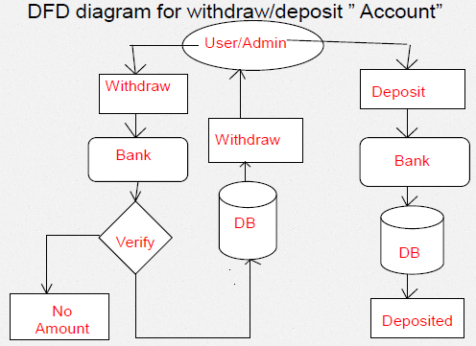

Slide 10
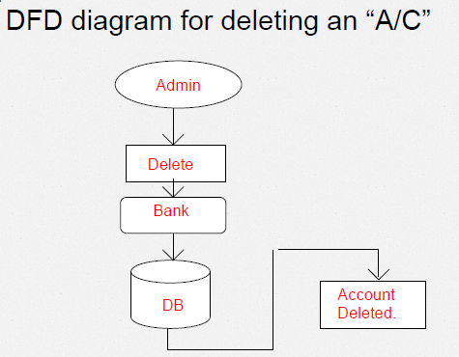

Slide 11
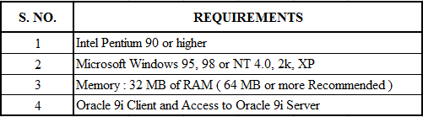
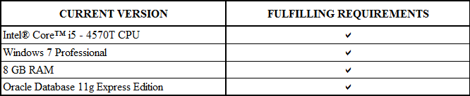
Software Requirements

Slide 12
TABLES uSED
User Details
Admin User Details
Name | Type
Account Number | Number(10)
User Name | Varchar2(40)
Password | Varchar2(20)
Date of Birth | Date
Contact Number | Number(10)
Email | Varchar2(50)
Account type | Varchar2(30)
Address | Varchar2(10)
Balance | Number
Name | Type
Account Number | Number(10)
User Name | Varchar2(40)
Password | Varchar2(20)
Date of Birth | Date
Contact Number | Number(10)
Email | Varchar2(50)
Account type | Varchar2(30)
Address | Varchar2(10)
Balance | Number
Date of Creation | Date

Slide 13
Contd…
Deleted Accounts table
Name | Type
Account Number | NUMBER(10)
User Name | VARCHAR2(40)
Balance | NUMBER
Deletion Date | DATE

Slide 14
DEVELOPMENT PHASE

Slide 15
TOPICS USED FOR CODING
Subject | Topic Name
SQL | DDL, DML, DCL
SQL | External Tables
PL/SQL | Procedures
PL/SQL | Exception Handling
PL/SQL | Cursors

Slide 16
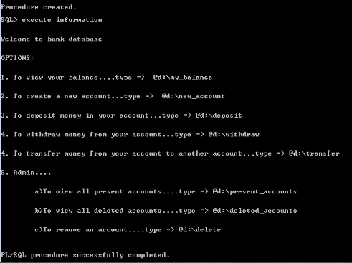
Query snapshot

Slide 17
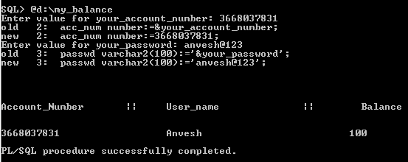
1.To view balance

Slide 18
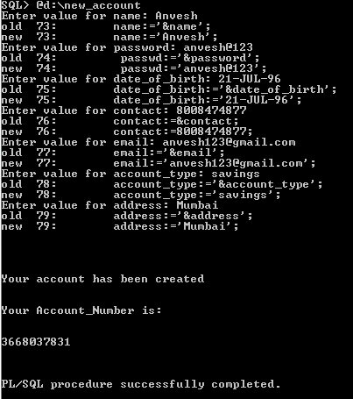
2. Create new account

Slide 19
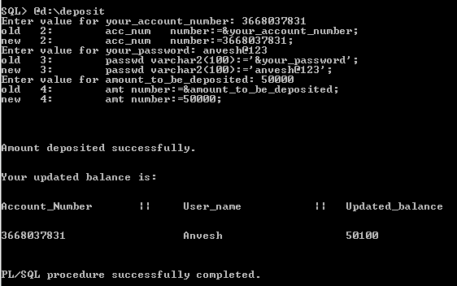
3. To deposit money into account

Slide 20
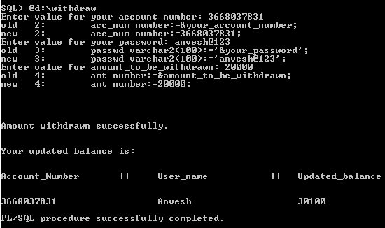
4. Withdraw money

Slide 21
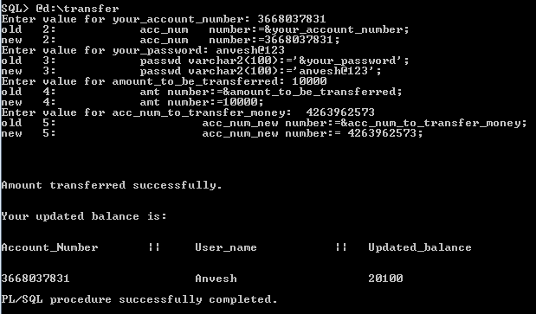
5.Transfer money

Slide 22
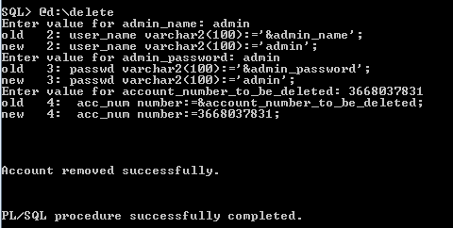
Remove account

Slide 23
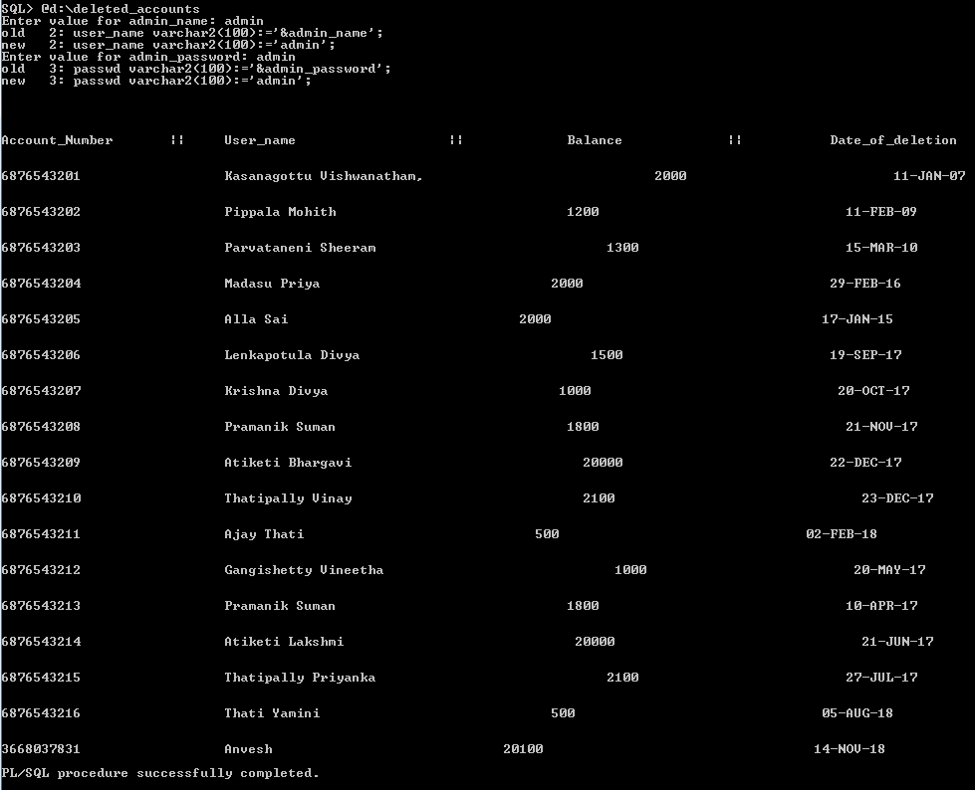
List of deleted accounted

Slide 24

THANK YOU

